Slide 1
Year Two
Parent
Workshop
2021/2022

Slide 2
Transition to Year Two this year…
This half term we will help the children to feel settled and practise their new daily routines.
Our main focus will be for all children to feel happy and safe to be back at school
We will continue to teach them some simple, age appropriate strategies to support their mental health and well-being and this will be called ‘Our Daily Pause’. This will include taking part in Circle Time and various breathing exercises.
The children will continue to use a ‘Feelings Journey’ book where they can express their thoughts and feelings.

Slide 3
Covid’19
We are following the latest statutory Government guidelines relating to on-going COVID safe measure in school.
Children will no longer be assigned ‘class bubbles’ and parents are welcomed back on site.
We will retain the following safety measures;
Extra hygiene measures – washing/sanitising regularly
Well ventilated classrooms and communal areas
Outside learning where possible
Voluntary testing for all staff twice a week
Maintain staggered start time at 9:00-9:10AM
Visitor disclaimer forms to minimise risk of infection
PPE available to staff – particularly for close contact care

Slide 4
The Year Two
Curriculum

Slide 6
All Different, All Equal, All Achieving
At Park Hill Infant School we continue to teach the children about what it means to be strong, positive and productive members of society.
We have always taught our pupils about equality and this remains an important part of our curriculum.
We consistently work together to support and meet the needs; of children of all genders, of children with special educational needs, of children who are more able, of children with disabilities, of children from all socio-economic backgrounds, of children from all ethnic groups, of children from all religions and of children with a diverse range of linguistic backgrounds.

Slide 7
Our Curriculum
Your child will have taken part in some informal assessments during their first 2 weeks back at school and we will work on any areas which they have not fully retained from last year.
Children who are in need of extra support will receive extra support in class as well as in interventions with teaching staff to ensure that every child makes the progress they need this year.
In Year Two we cover all areas of the National Curriculum in a range of lessons:
English (Phonics, Writing, Drama, Book Club/Reading),
Maths, Science, Computing, Geography, History, PSHE, RE, Art and Design, Design Technology and Music.

Slide 8
E-safety
We continue to educate all pupils on the importance of staying safe when using the internet. To enhance this, please think about some of the following ideas at home:
Maintain open discussions with your child and encourage them to talk to you about their internet use: for example who they’re talking to, services they’re using, and any issues they may be experiencing.
Give your child strategies to deal with any online content that they are not comfortable with – such as turning off the screen, telling an adult they trust and using online reporting facilities.
Consider using filtering software to block unwanted content. In addition to filtering, remember that discussion with your child, and involvement in their internet use, are both effective ways to educate them about the internet.
Familiarise yourself with the privacy settings and reporting features available on popular sites, services and apps.
Familiarise yourself with the age ratings for games and apps and ensure that any apps your child uses are age appropriate.
Encourage your child to use nicknames (where possible) instead of their full name online, to protect their personal information, and create strong passwords for every account.
Please visit: https://www.childnet.com/parents-and-carers for more information and support

Slide 9
On-going initiatives
within our school…
Continuing to embed our School Values: Positivity, Respect, Honesty, Kindness and Courage
Continuing to utilise our Super Skills for Learning: Curiosity, Confidence, Creativity, Communicating, making Connections, Collaborating, Risk-taking, Reflecting, Persevering, and being Resourceful
Learning to Learn
Growth Mindset
Continuing to teach the knowledge and skills of the National Curriculum for Year One.

Slide 10
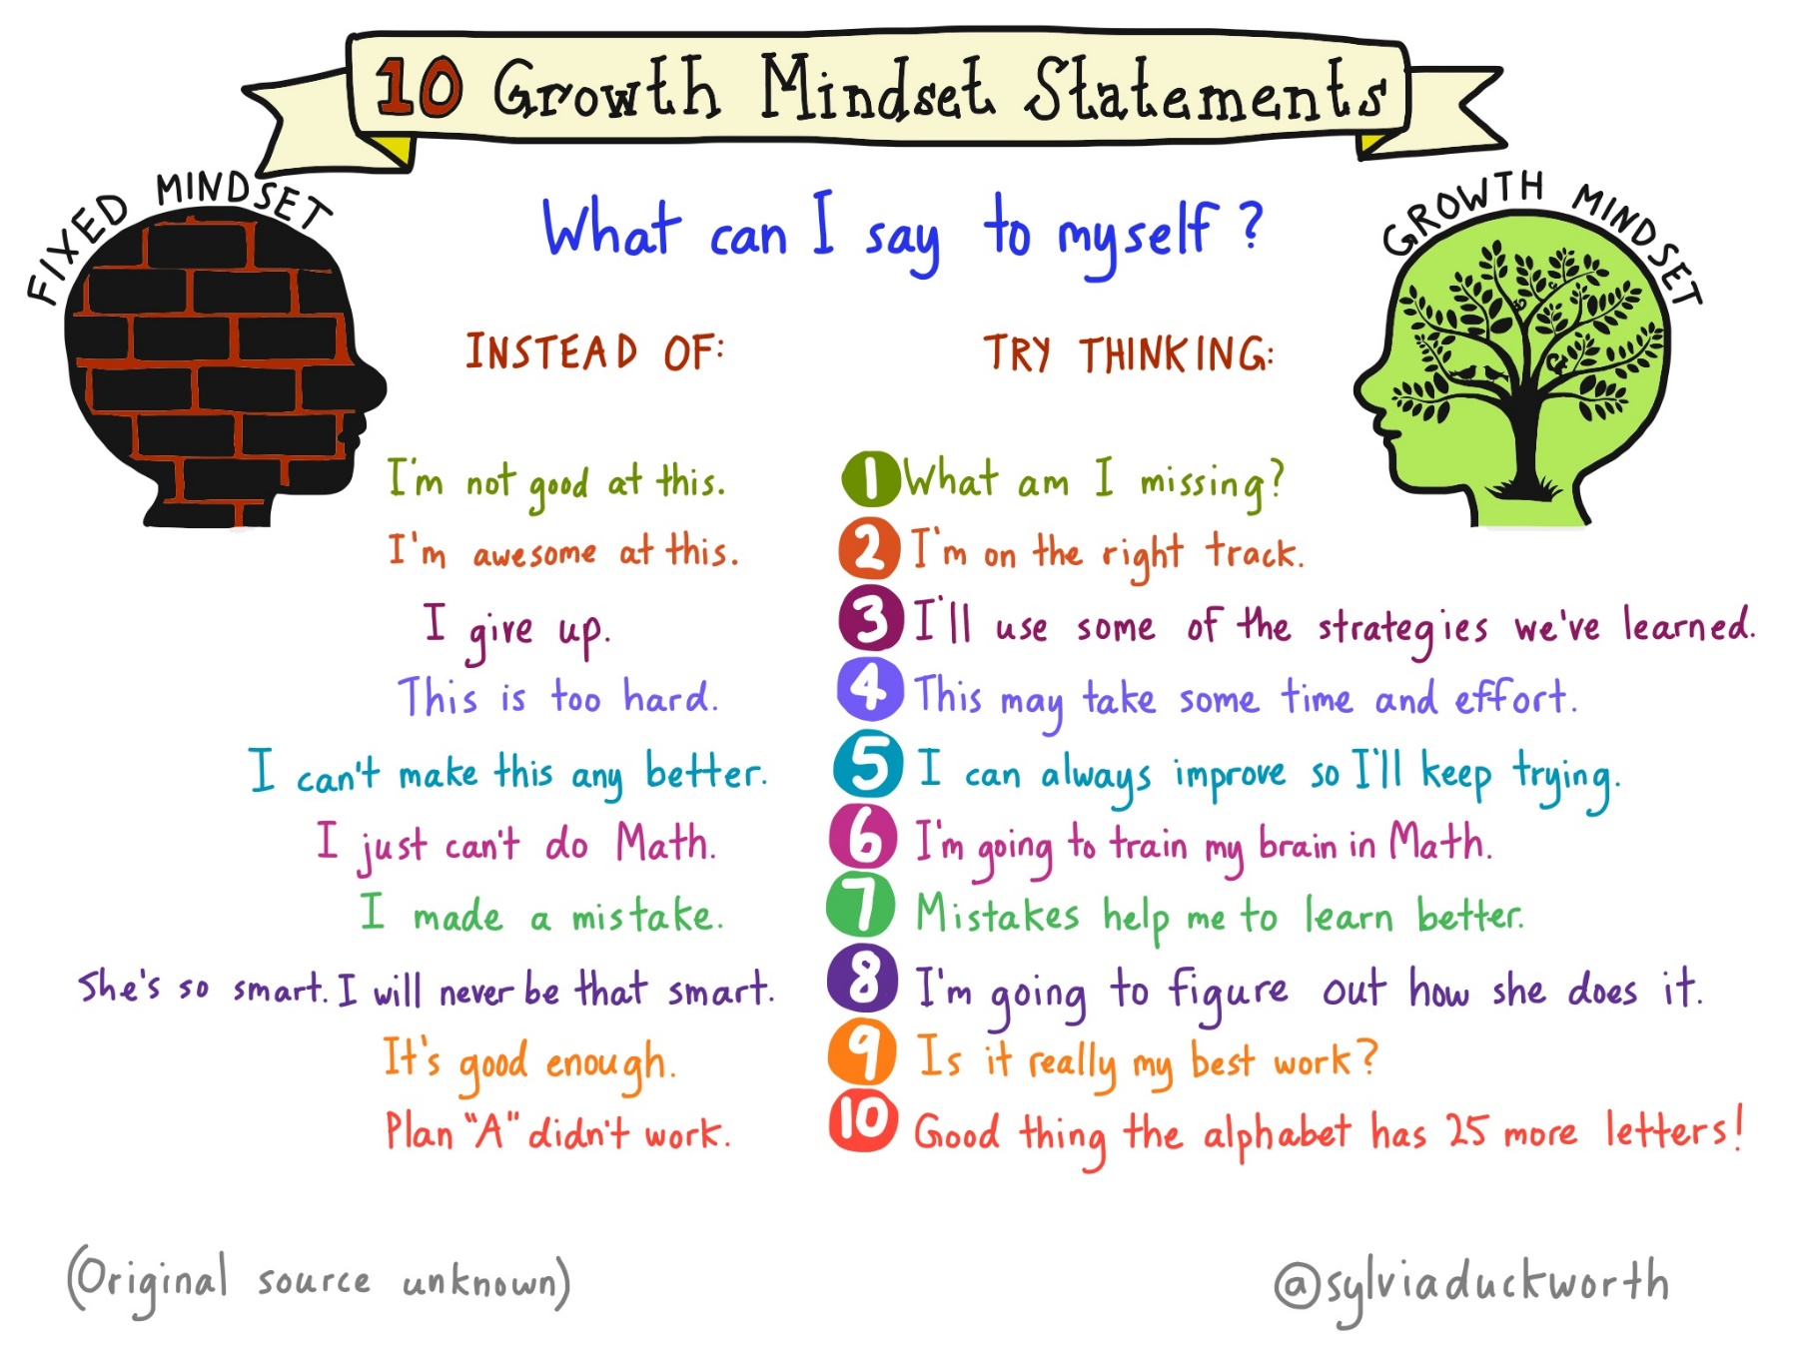
We talk to the children about using a ‘Growth Mindset’ when tackling new learning and challenges. This improves their resilience and confidence when learning independently.

Slide 11
Phonics
Children are taught phonics from when they start in Reception –
We follow ‘Little Wandle Letters and Sounds Revised’
This term in Year 2 we will focus on revising Phase 5
following Little Wandle
Children who need additional support will receive daily
specific support for their phase of learning
As the Year 1 phonics check did not take place in June
2021, children will complete the National Phonics
Screening Check in Year 2.
The benchmark score for this test is usually to successfully
read 32 of the 40 words. Any child who does not reach
the benchmark in the Autumn Term will be signposted to
intervention groups to support them further before they
take the test again in June 2022.

Slide 12
Phonics

Slide 13
Reading
Taught during….
Phonics sessions
Book Club sessions
Daily English sessions
https://www.youtube.com/watch?v=-v3XOsTF33Y
(Child reading at the Age related Expected Standard)
Key areas to focus on at home…
Use of phonics to sound out unknown words (Please use the ’Grow the Code’ Phonic sound mats attached)
Sight vocabulary of common words
Taking account of punctuation, for example pausing at full stops
Discussion of a book to increase your child’s comprehension
Use of expression and using different voices!

Slide 14
Writing
Taught during daily English sessions and weekly handwriting sessions.
Key areas to focus on at home…
Learning how to spell common words and use them in their writing (These will be sent home as weekly home learning; ‘Words of the Week’)
Using clearly formed letter formation and handwriting
Using capital letters and full stops in the correct places -
Extending sentences with conjunctions such as: and, because, also, if, but, so
Writing for a purpose (fiction/non-fiction) across genres
Sequencing sentences in order, sequencing events

Slide 15
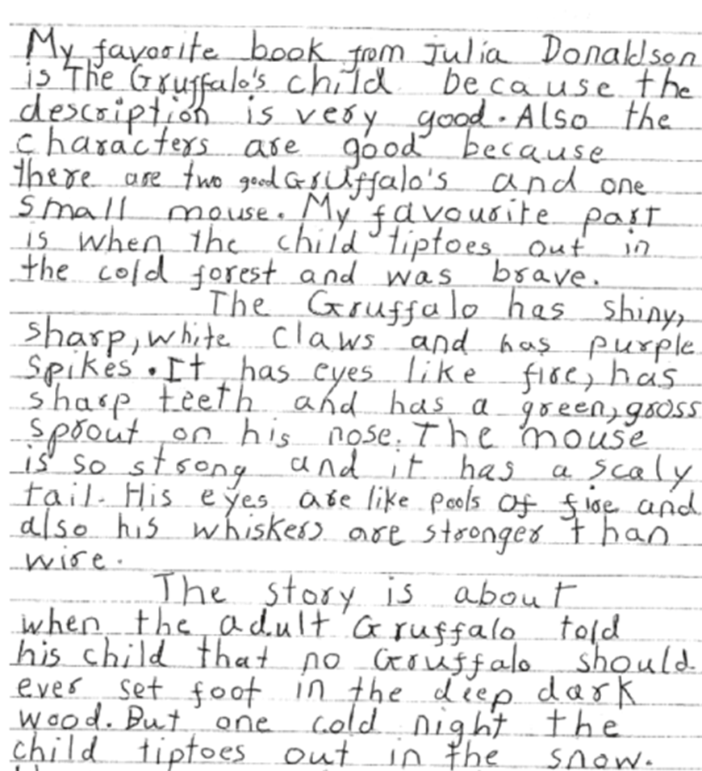
Writing
This is an example of a piece of independent writing, where we expect the majority of children to be at the end of Year Two.

Slide 16
Writing
Write simple, coherent narratives about personal experiences and those of others (real or fictional)
Write about real events, recording these simply and clearly
Use capital letters and full stops, and use question marks mostly correctly
Use present and past tense mostly correctly and consistently
Use co-ordination (e.g. or / and / but) and some subordination (e.g. when / if / that / because) to join clauses
Spell many common words correctly and make phonically-plausible attempts at others
Form capital letters and digits of the correct size, orientation and relationship to one another and to lower-case letters
Use spacing between words that reflects the size of the letters

Slide 17
Handwriting

Slide 18
Spelling
Children should know letters primarily by their sound. In Year 2 we revise and focus on a range of alternative pronunciations, spelling patterns, tricky words and adding suffixes.
(e.g. -ing, -ness, -ed, -ful)
Some of these spelling patterns will form part of the children’s weekly spelling practice. You will receive a spelling list each Friday for your child to practise.
We expect all children to practise the differentiated spellings, completing each section carefully. They should be handed in every Thursday and they will have a weekly ‘Spell Check’ on Thursdays to see if they have retained these words.
Children are then given the opportunity to put these spellings into their writing. There is a topic based writing challenge at the end of their weekly home learning, to write about a particular theme or genre using the words and skills which they have learnt that week.
Accurate spelling is practised so that the children can apply it in their independent writing…. Please do not become too obsessed with their weekly spelling score!!!! However, we will highlight the words your child was unable to spell so that you can revise them at home. If your child finds spelling practice particularly difficult at home, please speak to your child’s class teacher for support. We do not want them to become anxious or worried about the weekly ‘test’.

Slide 19
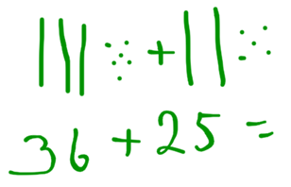
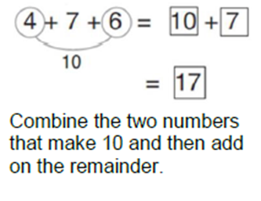
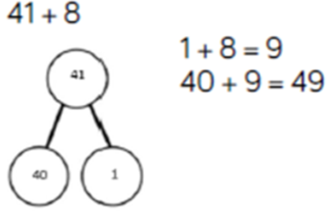
Maths
ADDITION

Slide 20
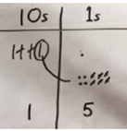
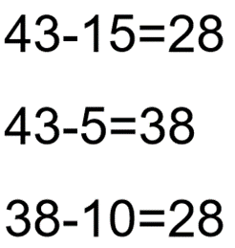
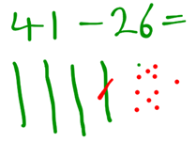
Represent the base 10 pictorially, assessing the equation, exchanging when needed.
Maths
SUBTRACTION
Represent the base 10 pictorially, assessing the equation, exchanging when needed.
Subtract either the 10s or 1s first then the other. Break the number down and count backwards.

Slide 21
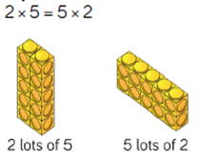
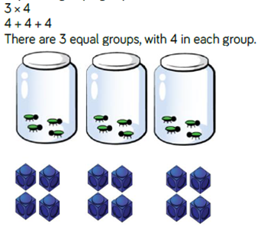
Represent the base 10 pictorially, assessing the equation, exchanging when needed.
Maths
MULTIPLICATION

Slide 22
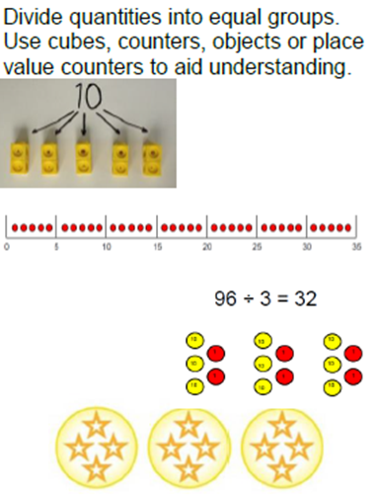
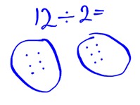
Represent the base 10 pictorially, assessing the equation, exchanging when needed.
Maths
DIVISION

Slide 23
P.E. Indoors and Outdoors
Children must have P.E. kits at school every day of the week (we will send it home when it needs a wash)
Please ensure everything is labelled
In colder weather the children will need warmer layers for outdoor PE
Some PE ‘fitness’ sessions will be of a higher intensity and your child will be expected to take part in all activities to the best of their ability!

Slide 24
Home School Learning
Children will receive 2 reading books per week.
Home – school learning folders:
Children will receive their new spelling list to learn on Fridays. These will be inside their home learning folder. They will then have a ‘Spell Check’ test the following Thursday.
Children should hand in their home learning folder on Thursdays so that their new spellings / learning challenges can be put in ready to take home on Friday.
IMPORTANT – The highlighted words are the words that the child got incorrect in the test.
Maths – KIRFs are sent home half termly for you to practise these quick recall facts with your child.
Your teachers will also send home a Topic-Based projects each half term. This will become your child’s ‘presentation’ which they will share with their class.
In addition to this there may be tasks set using the Online Learning platforms Mathletics, Reading Egg and Purple Mash, please hold on to all passwords you are given!

Slide 25
Parental Involvement
Re-establish parental involvement in learning
Thrilling Thursday (Thursday, September 30^{th)}
Family Curriculum Workshops
Head Teacher Award Assemblies – by invitation only
Information workshops – such as this!
Open Classroom
Dates are on the website but are subject to change in line with government guidelines

Slide 26
Helpful websites…
Little Wandle Letters and Sounds Phonics Programme.
https://www.littlewandlelettersandsounds.org.uk/resources/for-parents/
Reading Eggs
https://readingeggs.co.uk
Mathletics
http://www.mathletics.co.uk/
Purple Mash
http://www.purplemash.co.uk
http://www.bbc.co.uk/schools/parents/school_education/
(information about schools and learning)
http://www.bbc.co.uk/learningzone/clips/

