Slide 1
Year One
Parent
Workshop
2017

Slide 2
On-going initiatives for 2017…
Continuing to embed the Super Skills for Learning
Transition arrangements from Early Years
Outdoor area/learning
Personalised creative curriculum – half termly topic web
Continuing to teach the New English and Maths curriculum for Year One.
Maths challenges
“Mastering” the curriculum rather than rushing through content

Slide 3
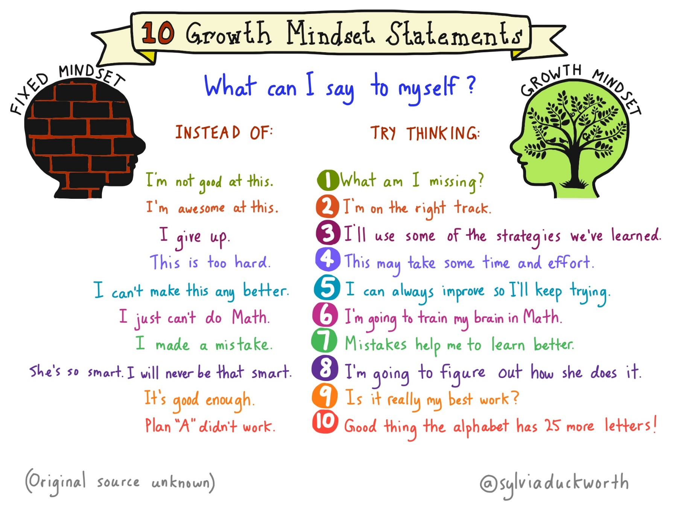

Slide 4
Areas covered
Reading
Writing
Maths
Other subjects
PE
Home learning
Questions

Slide 5
The examples of where the children should be are a guideline and NOT exact. Every child is different and will work from their own starting points.

Slide 6
Reading
Key areas to focus on…
Use of phonics to sound out unknown words
Sight vocabulary of high frequency words
Taking account of punctuation, for example pausing at full stops
Discussion of a book to increase your child’s comprehension
Use of expression and using different voices!
READ FOR ENJOYMENT!!

Slide 7
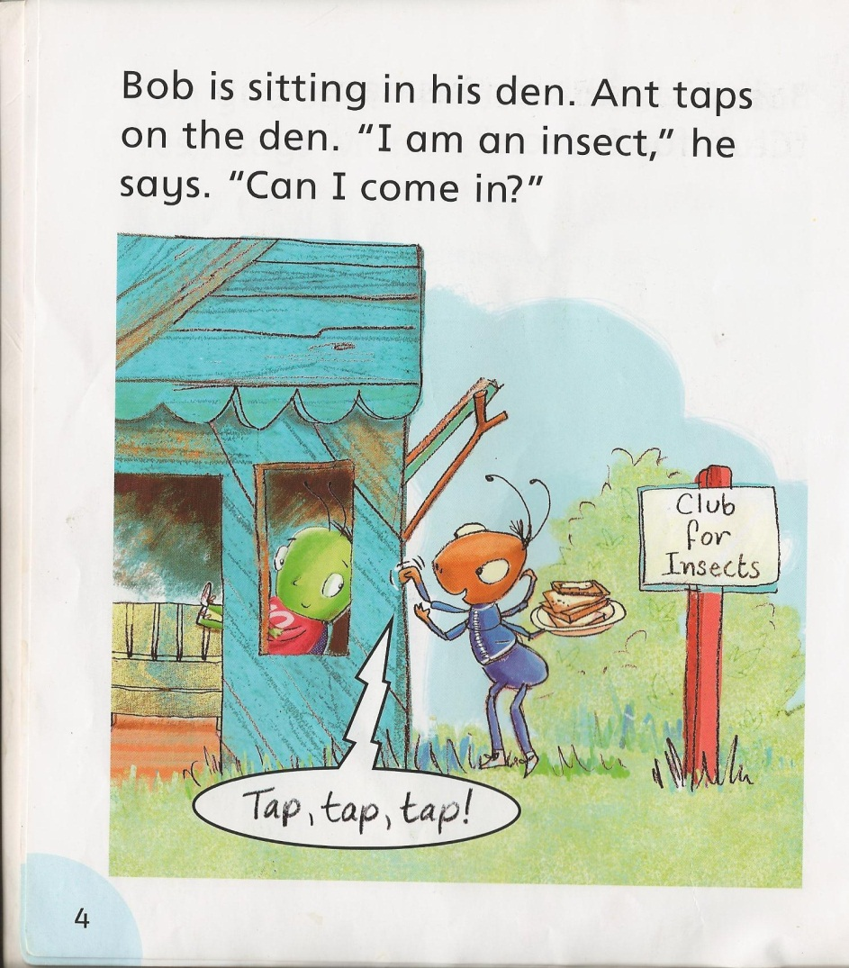
Reading
This is an example of a book, where we expect the majority of children to be at the beginning of Year One.
Uses mainly phonetic words
Contains high frequency words
Clear picture clues

Slide 8
Reading
This is an example of a book, where we expect the majority of children to be at the end of Year One.
More punctuation used
More complex sentences
Extended vocabulary
Some general picture clues

Slide 9
Phonics
Over the course of the year the children will revise all phase 3, 4 & 5 sounds through daily sessions in class.
Children will be taught to break up words into their sounds, and then blend the sounds together to read the word.
There will be a National Phonic Screening check in June 2018 where all children will be assessed on their phonetic knowledge. This is done by asking the children to read real and ‘alien’ words.
A Phonic workshop will be held prior to the check with more information.

Slide 10
Writing
Key areas to focus on…
The use of phonics is very important
Learning how to spell high frequency words and use them in their writing (Words of the Week)
Using capital letters and full stops consistently
Once confident in using correct punctuation extending sentences with conjunctions such as and, because, also, if, but, so
Ensure writing engages the reader – creative, exciting
Writing for a purpose (fiction/non-fiction)

Slide 11
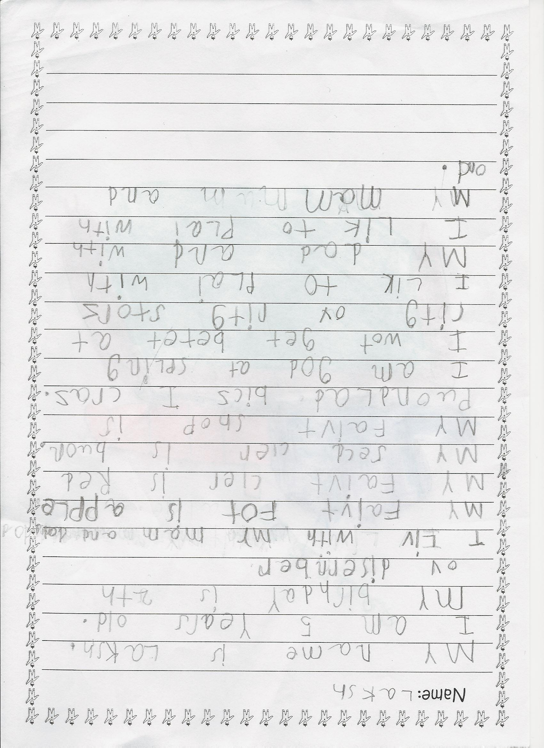
Writing
This is an example of a piece of independent writing, where we expect the majority of children to be at the beginning of Year One.
An awareness of full stops, but they are not always in the right place
Phonetic attempts at unknown words
Some high frequency words are spelt correctly
Some irregularities in letter size and orientation

Slide 12
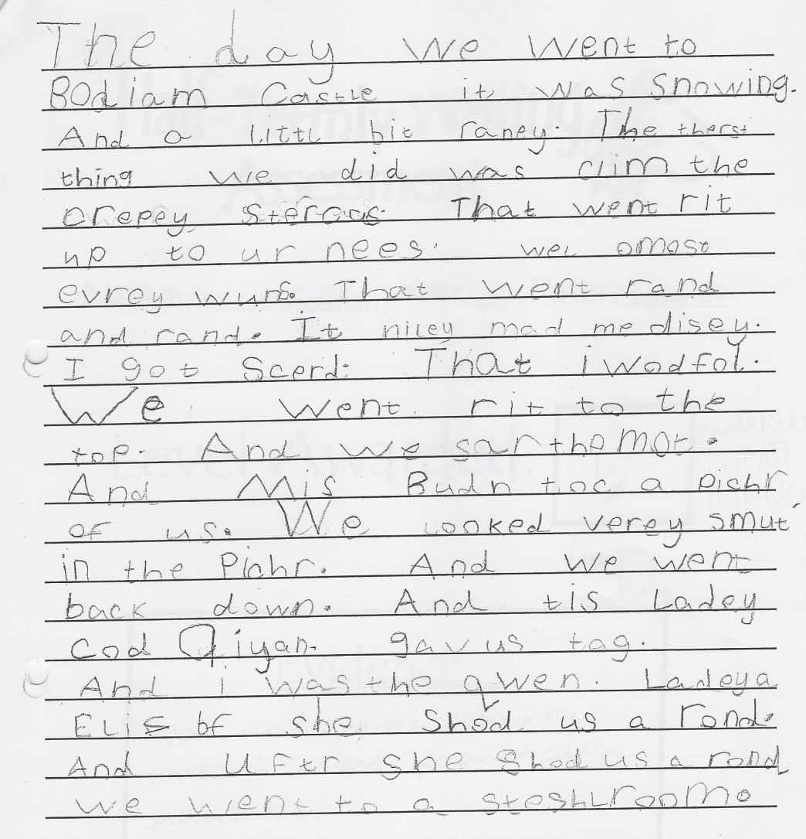
Writing
This is an example of a piece of independent writing, where we expect the majority of children to be at the end of Year One.
Attempting to extend sentences
Consistently using full stops and capital letters
Different sentence starters
High frequency words spelled correctly
Phonetic attempts at unknown words

Slide 13
Maths
Key points…
Relating to real life to solve problems
Very practically based
Understanding processes, not learning facts
Understanding the order of numbers – place value
Writing digits appropriately
NO VERTICAL ADDITION!
Maths is not just about number! – Time, money, shape, measure.
Mastering the curriculum – e.g partitioning in different ways or bridging through tens when adding

Slide 14
Maths
Addition and Subtraction …
Practical use of objects – touch the objects and say the number, (1:1 counting), begin to record using appropriate signs
Reading the ‘number sentence’ – what does it mean? What is it asking you to do?
Counting on/back – e.g. 3+2… put 3 in your head and count on 2. Understand a variety of formats such as 7=?+2
Use of a number square
22+5 – largest number in your head and count on
Using a number line
Giving the children a variety of techniques and letting them choose which one they enjoy using

Slide 15
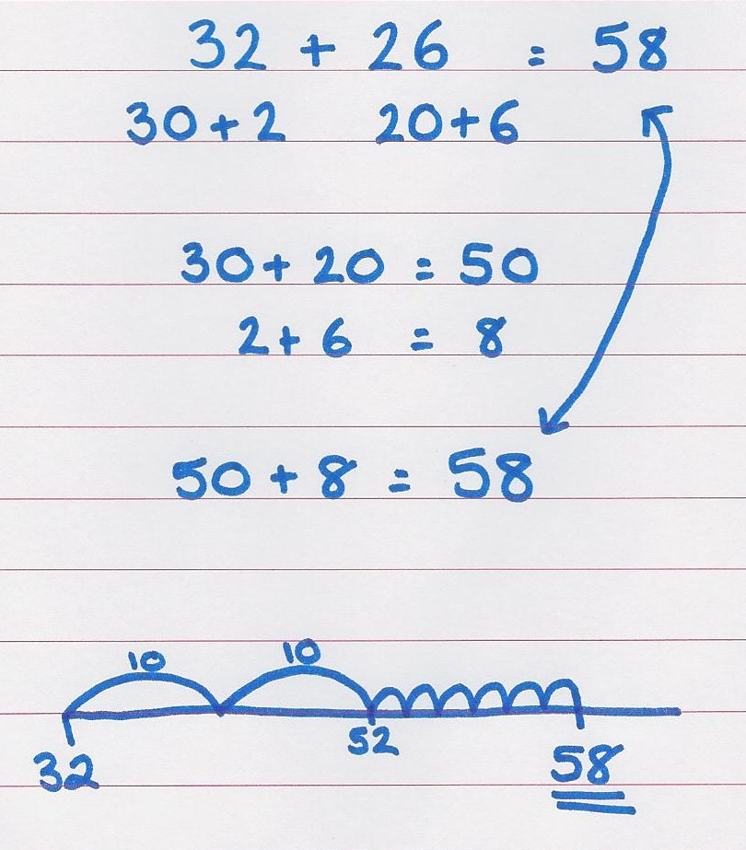
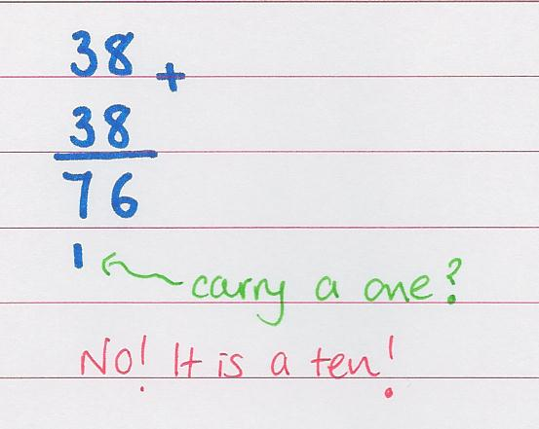
Maths
Partitioning and number lines …
NO VERTICAL ADDITION!

Slide 16
Word problems

Slide 17
Maths…
not just about number!
Measure – length, height, weight, coins
Time – reading the time, solving problems
Shapes – 2D and 3D shapes and their properties
Understanding the combination of all aspects
Fractions are also covered in Year One

Slide 18
All the other subjects!
In Year One we also cover computing, geography, history, science, PSHE, guided reading, RE, art, design technology and music.

Slide 19
P.E.
Indoors and Outdoors
Children must have P.E. kits at school every day of the week.
Children will go onto the Junior School field for outdoor P.E. therefore the children must have a tracksuit for the winter months.
Swimming will take place in the Summer term for Year 1.

Slide 20
Home School Learning
Children will receive 2 reading books per week. Library books are also available for your child to choose to take home once the class teacher decides its appropriate.
Every Friday your child will receive ‘Words of the Week’. It will comprise of high frequency words and a further challenge for children to apply the spelling of these words to also.
This work must be completed and returned to school the following Thursday.

Slide 21
Home School Learning
As well as words of the week there will be a homework project depending on the topic. For example a country study during our Around the World topic.
There is not a set time for show and tell.
Children can bring things to show that are related to our topic.
Handwriting will continue to be a focus throughout home and school learning – try to encourage good habits such as pencil grip and letter formation.

Slide 22
Helpful websites…
http://www.bbc.co.uk/learningzone/clips/
www.educationcity.com
http://www.bbc.co.uk/schools/parents/school_education/
(information about schools and learning)
http://jollylearning.co.uk/
(information about phonics and how to say the sounds)
http://www.ictgames.com/
(Maths and Literacy games)
http://www.mathletics.co.uk/
(Math’s homework learning portal)

