Slide 1
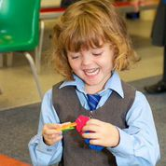
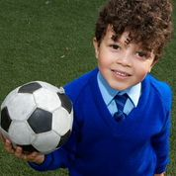
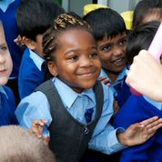
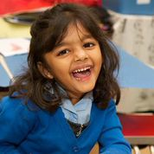
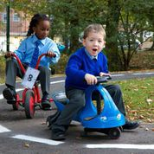
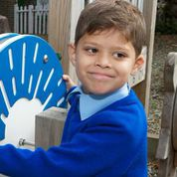
Welcome to Reception

Slide 2
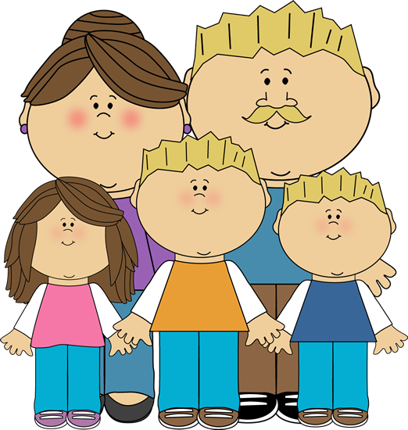
Aims of this Workshop
Give an overview of the Foundation Stage Profile
Gain an insight into your child’s day at school
Clarify homework
Develop understanding of phonics
Inform you of the opportunities your child will have in our setting

Slide 3
Foundation Stage Profile
Prime Areas
The prime areas are those most essential for your child’s healthy development and future learning.
Communication and Language
Physical Development
Personal, Social and Emotional Development
Specific Areas
As children grow, the prime areas will help them to develop skills in four specific areas.
Literacy
Mathematics
Understanding the World
Expressive Arts and Design

Slide 4
Communication
and Language

Slide 5
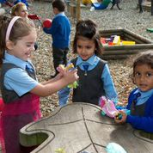
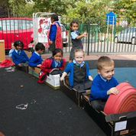
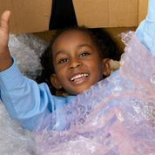
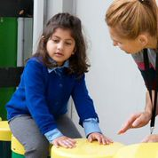

Slide 6
Physical Development

Slide 7
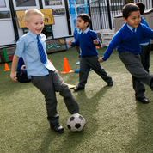
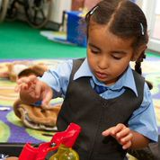
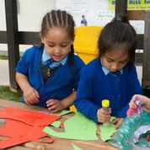

Slide 8
Personal, Social, Emotional development

Slide 9
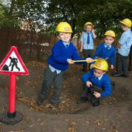

Slide 10
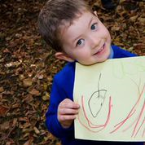
Literacy
Reading outcomes:
Read and understand simple sentences
Use of Phonics to decipher words
Common irregular words
Comprehension of what was read
Writing outcomes:
Use of phonics to write words which match their spoken sounds.
Write some irregular common words.
Write simple sentences which can be read by themselves and others.
Some words are spelt correctly and other are phonetically plausible.
Notes:
Reading ELG:
Children read and understand simple sentences. They use phonic knowledge to decode regular words and read them accurately. They also read some common irregular words. They demonstrate understanding when talking with others about what they have read
Writing ELG:
Children use their phonics knowledge to write words in ways which match their spoken sounds. They also write some irregular common words. They write simple sentences which can be read by themselves and others. Some words are spelt correctly and other are phonetically plausible.

Slide 11
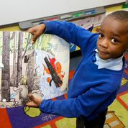
Phonics
Phonics teaching enables children to read and write
We learn the letter sound first and then the name of the letter through differentiated phases.
We teach phonics in a fast pace way to enable children to begin to blend words quickly.
It is also important for children to learn tricky words by sight.
At Home
Children will be given a sticker with the sound they have learnt that day on so you can help them practise at home.
Praise all efforts – remember phonetically plausible words are ok.
After sounding a word out always attempt to blend the sounds together. Model and demonstrate this for your child.

Slide 12
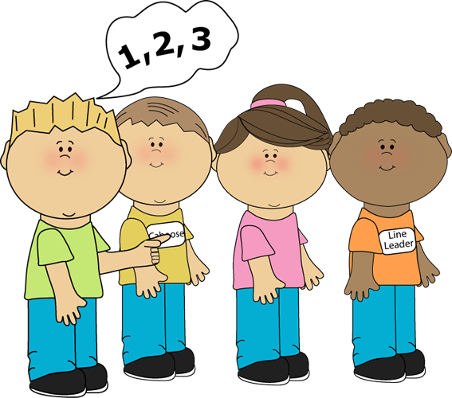
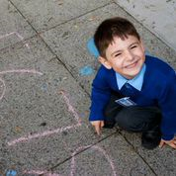
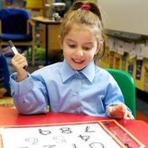
Mathematics
Number outcomes:
Children count reliably using numbers from 1 to 20,
Children understand number order
Children are able to add and subtract
Problem solving (doubles, halving and sharing)
Shape, space and measure outcomes:
Use everyday language to talk about size, weight, capacity, position, distance, time and money to compare quantities and objects to solve problems.
Recognise, create and describe patterns.
Explore characteristics of everyday objects and shapes using mathematical language.
Notes:
Numbers ELG:
Children count reliably with numbers from on to 20, place them in order and say which number is one more or less than a give number. Using quantities and objects, they add and subtract two single-digit numbers and count on or back to find the answer. They solve problems, including doubling, halving and sharing.
Shape, space and measure ELG:
Children will use everyday language to talk about size, weight, capacity, position, distance, time and money to compare quantities and objects to solve problems. They recognise, create and describe patterns. They explore characteristics of everyday objects and shapes and use mathematical language to describe them.

Slide 13
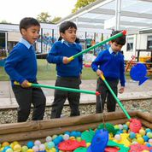
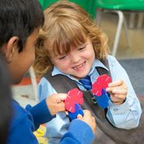
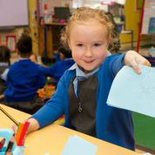
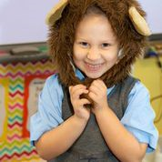
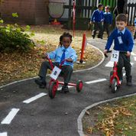
A Day in the life of..
9.10 Early Morning Work
9.30 Whole class learning session – Phonics
10.00 Children choose their own learning. Focused group activities take place with adults.
12.00 Mathematics whole class teaching session
12.15 Lunch
12.45 Outside play time
1.30 Afternoon register. Whole class learning session.
1.45 Children choose their own learning. Focused group activities with adults.
3.00 Recap the days learning, story time, circle time.
3.30 Home Time!
Reception gate will be open from 9am – please do not play with the toy or resources whilst you wait.

Slide 14
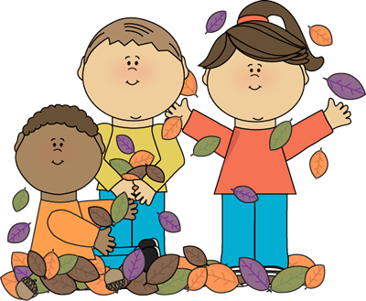
How your child learns…
Playing and exploring
Active learning
Creative and critical thinking
Key aspects of ‘Effective Learning’ characteristics include children:
being willing to have a go
being involved and concentrating
having their own ideas
choosing ways to do things
finding new ways
enjoying achieving what they set out to do
Notes:
Children in Reception learn by playing and exploring, being active, and through creative and critical thinking which takes place in both the indoor and outdoor classrooms.
Activities are planned carefully by our teachers to facilitate this type of learning and suited to your child’s unique needs and interests.
Key aspects of Effective Learning Characteristics include children:
being willing to have a go;
being involved and concentrating;
having their own ideas;
choosing ways to do things;
finding new ways; and
enjoying achieving what they set out to do.

Slide 15
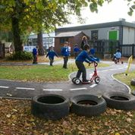
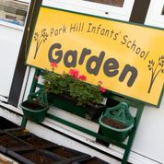
How do we facilitate this learning?
Various role play areas
Sensory exploration – sand and water trays
Paint mixing stations
Expressive arts on our stage
Racing track
Gardening
Junk Modelling
Literacy areas
Mathematics areas
Book Corners
Access to ICT
Superskills for Learning

Slide 16
Superskills for learning
In order for all children to achieve their full potential we encourage the use of our ‘Superskills for Learning’. Please promote these skills at home so that children can use them in all areas of life.
A ‘super-learner’ is always…
Creative, reflective, confident, resourceful and curious.
A ‘super-learner’ always…
Takes risks, makes connections, collaborates, communicates and perseveres.

Slide 17
Learning Journeys
Reception staff constantly monitor, observe and record your child’s learning carefully. These observations are recorded in an individual and unique scrapbook belonging to your child. These ‘Learning Journeys’ show your child’s progress and special learning moments during their time in Reception.
Children ‘Self Assess’ their own learning. They look back through their learning journey and make comments on what they have achieved. This is completed on a self assessment sticker.
Parents contribute to their child’s learning journey by completing ‘Wow moment’ stickers. These are really important and every child should have parental contribution in their learning journey.
There will be opportunities at open classrooms for you to view your child’s ‘Learning Journey’ and celebrate your child’s learning.

Slide 18
Learning Journeys
Parents contribute to their child’s learning journey by completing ‘Wow moment’ stickers. These are really important and every child should have parental contribution in their learning journey.
Please don’t be shy to ask for more notes if you need them…

Slide 19
Open Classrooms
Open classrooms take place once a term.
You will be invited into your child’s class after school.
This is not a time to talk to the teacher about your child’s progress but is an opportunity for you to look at the classroom environment and your child’s learning journey. Let your child guide you around their learning environment to show and tell you what they have been learning.
There will be an opportunity for you to meet with the class teacher to discuss your child’s progress and achievement every term during the parent consultation evenings.

Slide 20
Terrific Tuesdays
Terrific Tuesdays will start after half term.
Every Tuesday you will have the opportunity to come and work with your child in class on a pre-prepared learning activity. If you are unable to attend yourself then a family member is welcome to attend in your place. It is a great way for you to become involved in your child’s learning and school life.
Different activities will be set up within the classroom – so come in and learn with your child.
This is not a time to discuss your child’s progress with the teacher but to engage in learning activities with your child.
Sessions run from 9:10am until 9:30am and are not compulsory. If no one from your family is able to attend your child will work with their peers or other adults within the school on the learning activities within the classroom.

Slide 21
Homework
Phonics
Handwriting
Monday to Friday your child will wear a sticker home with the sound they learned that day. Please help them practise this. Focus on oral development of the sound.
Reading Books
Every week all children will receive two books to share at home. They will have the opportunity to read with a member of school staff at least twice a week.
After half term the children will have a hand writing book.
We will discuss this further when they are sent home.

Slide 22
Fronter
Fronter is an online learning platform.
We use Fronter in school for children to access websites and other resources safely.
Each child will be given their own log in and this should be kept personal to them.
You will be able to log in at home and view our Reception page to see what your child as been learning at school. It will also contain a weekly practical maths challenge set by Mrs Parry for you to complete with your child at home.
You will also be able to access various websites we use in school safely.
All websites have been thoroughly checked by staff before being put on Fronter.

Slide 23
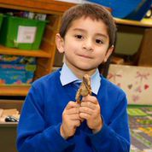
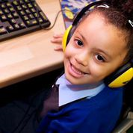
What else goes on at our school?
Access to the ‘Cooking Room’ – Toast Bar
Formal PE lessons once a week
Trips to the ICT suite
Various workshops throughout the year covering all areas of the curriculum

Slide 24
Thank you for attending our Reception Workshop
Any questions?

